Slide 1
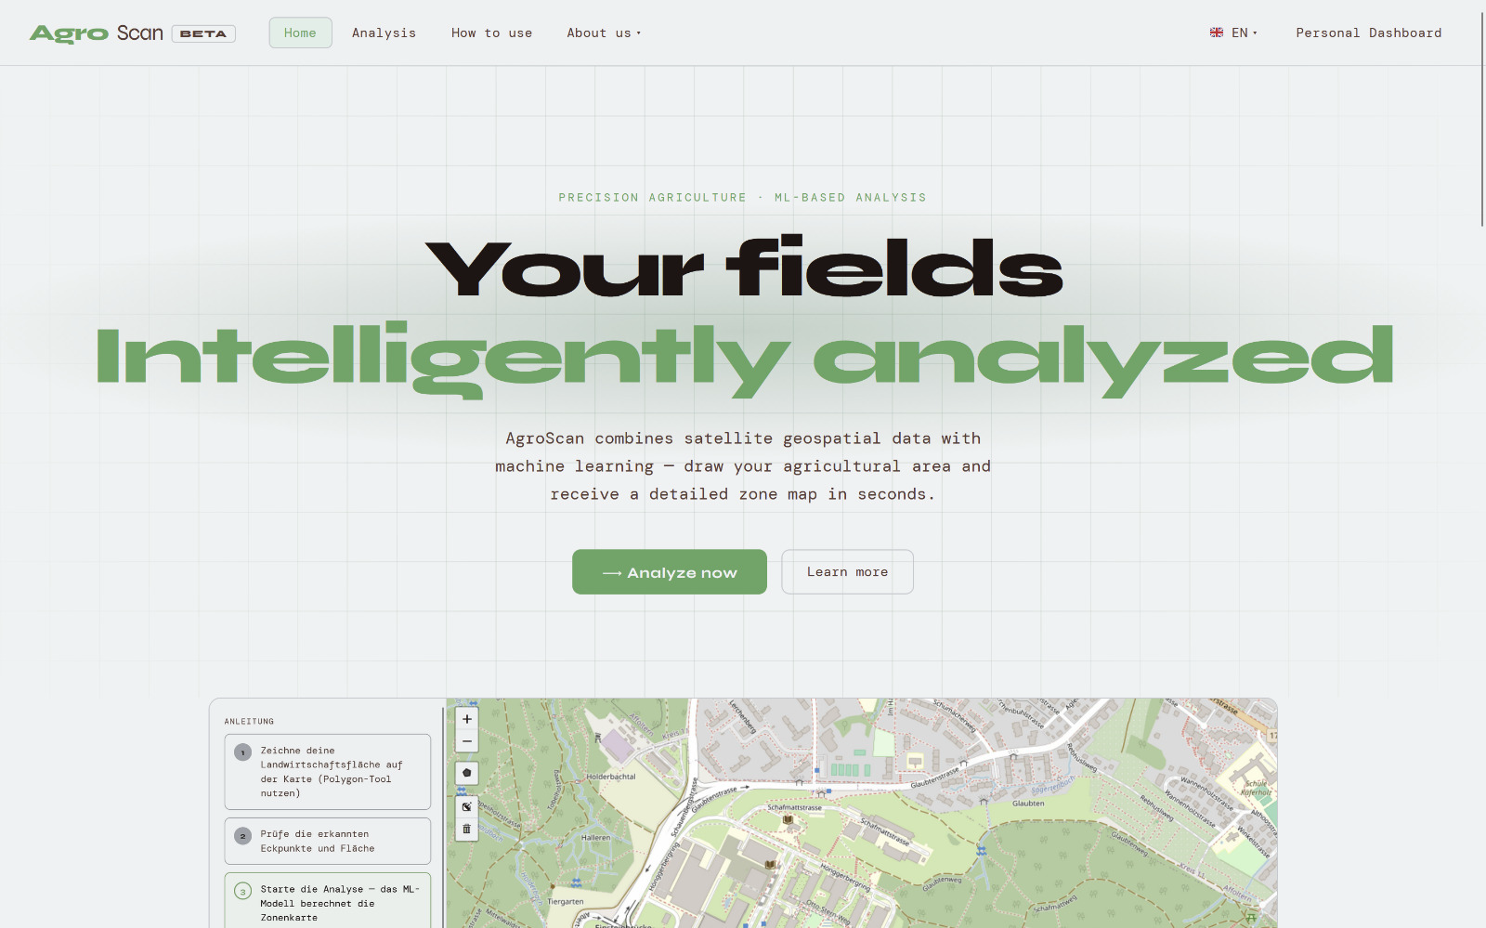
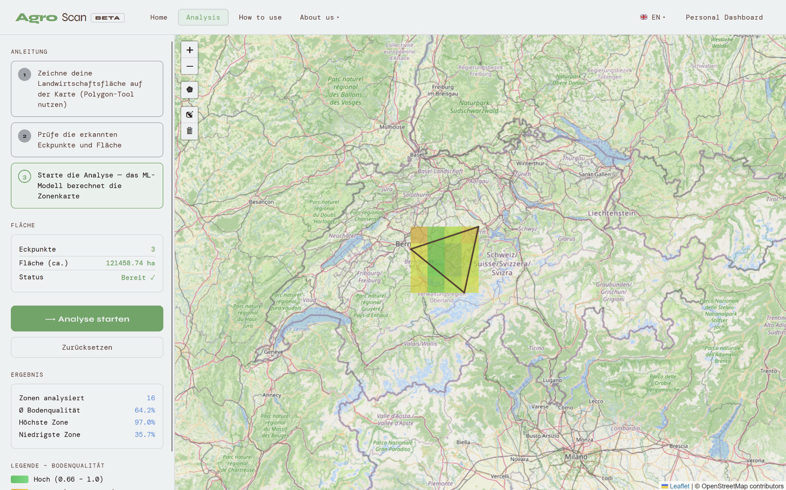
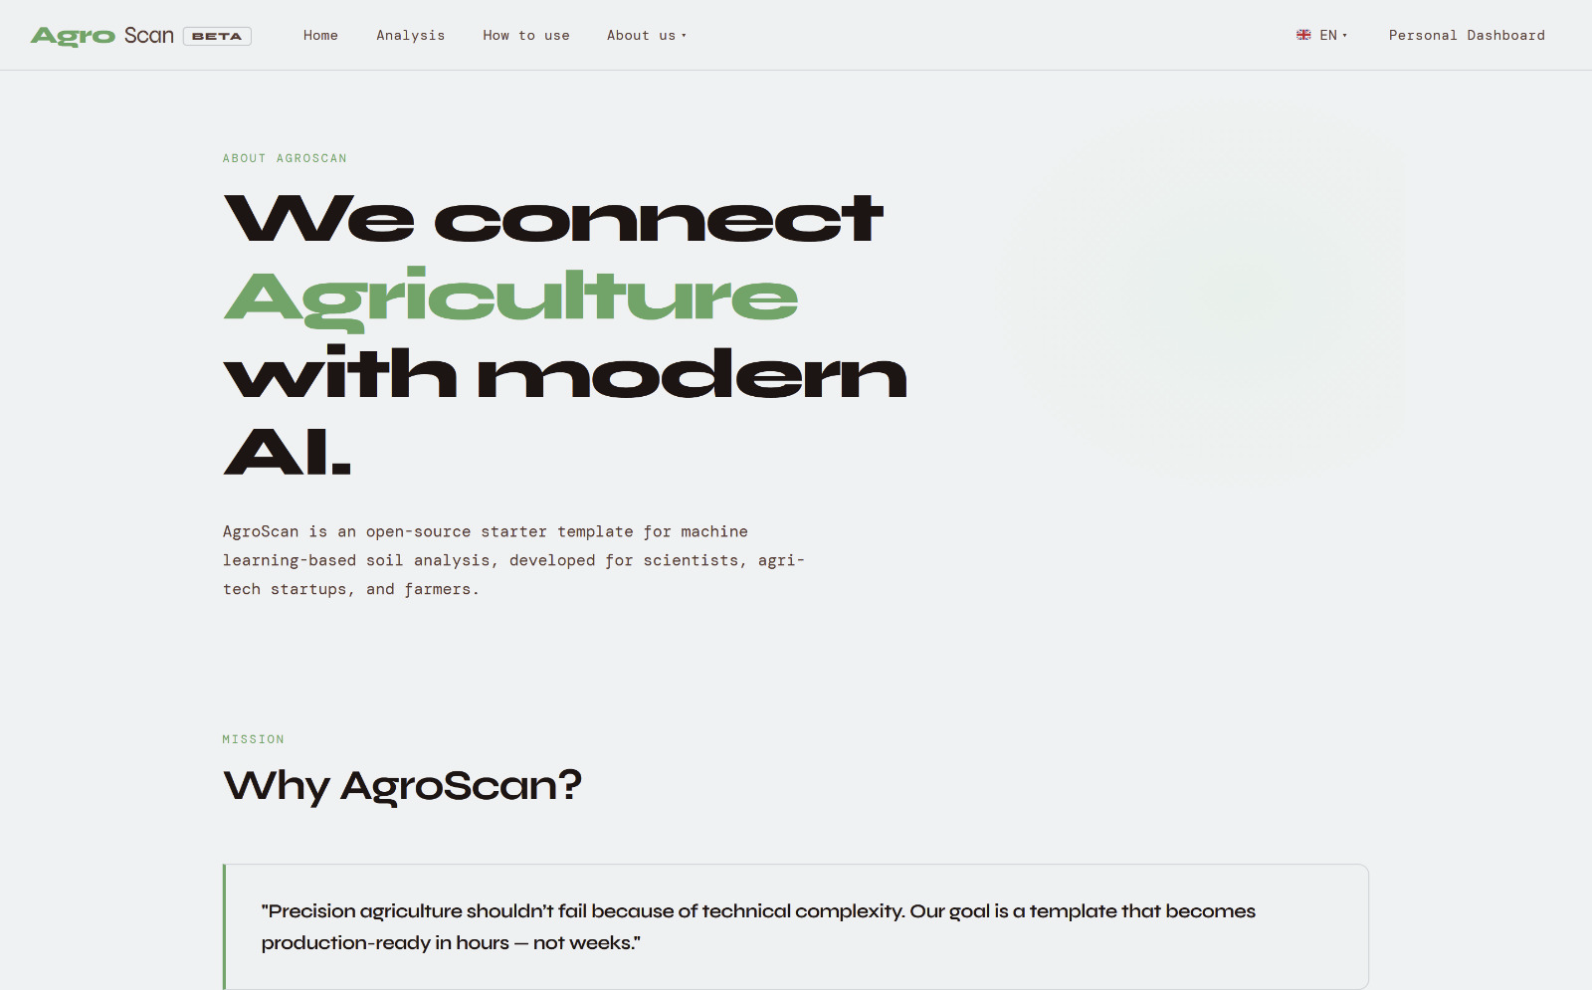
Progress Update – Satellite-powered SOC Monitoring (1/2)
Website - Tasks
Status
Defined user profiles & requirements and formulates website functionalities
Johannes
Part-time farmer
Language selection
Field localization on map via search function
Selection of field in polygon shape on map
Visualization of carbon content
Personal dashboard for progress tracking
Anton
Eco-Farmer
Developed website structure
>
Future work:
Completion of UI/UX design
Integration of satellite download & ML model into website
User testing
Develop & test website functionalities

Slide 2
Progress Update – Satellite-powered SOC Monitoring (2/2)
ML Model - Tasks
Status
Satellite data download & processing
Sentinel 2 data download successful
Sentinel 1 data download in progress
Feature transformation & construction of training data set
Sentinel 2 feature transformation successful
Sentinel 1 feature transformation in progress
>
Future work:
Training and comparison of neural network, random forest, regression and xgboost models – code base already exists on GitHub
Training & implementation of models

Slide 3
Questions – Satellite-powered SOC Monitoring
Can we host our website on GitLab during the duration of the course?
Can we receive sample reports and posters?
Do you have experience with integrating an automatized SNAP processing workflow for Sentinel 1 data into a live web application and if yes, can you recommend doing this for the intended project scope?
Note: Due to our recent call we have not collected any more questions.

